Slide 1
DKG- Key Women Educators Impacting Education Worldwide
Beta Pi Newsletter
January, 2024 • Vol. 21 Issue 4• Union County
January Meeting 2024
Letter from
Dr. Dawn
Location: Old Town Grill
Time: 5:30
Program: Legislation/Elect Officers
Hostesses: Donna & April
They would like a head count. Please fill out this form.
Donna will give us an update on pending and recent legislation pertaining to education. We will also elect a slate of officers for the upcoming biennium. There is officer training in March and April across the state. We will also have an update for Schools for Africa.
Happy New Year!
2024 holds lots of exciting possibilities for our Beta Pi sisters, and I hope you can find time to join us in the upcoming activities and events.
This change of the calendar to a new year is a good time to commit to making room in your agenda for DKG.
From professional development to fellowship, we hope your new calendar has room for Beta Pi!
Check out all of the virtual events happening at the state level here.
WHAT’S HAPPENING IN DKG
Beta Pi
TN State
DKG
Jan. Meeting
1/12: 5:30 pm @Old Town Grill - Tazewell
Legislative/Elect Officers
Purposes: 4 & 7
Hostesses: Donna & April
Important Dates
1/15: Beginning Leadership Devt. Apps Due
2/1: Scholarship Apps Due
2/29: HS Essays Due
TNSO Calendar link
TNSO Google Calendar
Important Dates
2/1: Scholarship Apps Due
2/15: Arts & Humanities Submissions Due for Spring
-Dawn
The Delta Kappa Society International promotes professional and personal growth of women educators and excellence in education.
“In Harmony”

Slide 2
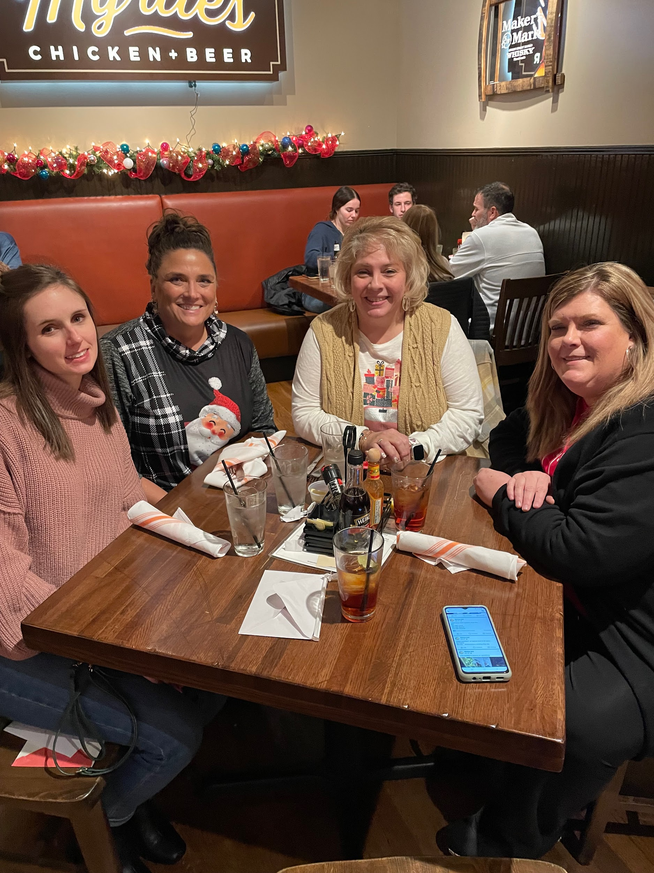
Chapter Member Spotlight
Society Websites
DKG: www.dkg.org
TNSO: www.tndkg.org
Beta Pi:
www.xibetapi.weebly.com
Christmas Downtown
Beta Pi members met on Market Square for the Christmas dinner and ornament swap. We braved the cold temperatures and decided to eat at Myrtle’s for some yummy fried chicken and tomato pie. We swapped some really festive ornaments, and had a fun time together.
DKG on Social Media
Xi State DKG
Attendance Drawing
We will start putting our names into a drawing for a prize in May.
One entry per meeting.
Educational/Legislative Update in Tennessee
Points Donna will cover:
- Education Freedom Scholarship Act - Vouchers
- Increase teacher supply from $200 to $600
- 1 Credit of Data Science = 1 Math
- Annual review of ELA textbooks
Passed House/Senate:
TN Future Teacher Scholarship 5 yr. pilot
Member Spotlight Form
Beta Pi Dues
Active - $85
Reserve - $58
No birthdays for Jan & Feb
Beta Pi Birthdays

